Slide 1
WQD7005 (DATA MINING)
Milestone 5 :
Web Deployment (Flask)
Title : “Blood Bank Website”
Prepared by :
Sivanesan Pillai
WQD 170074

Slide 2
An introduction to the Flask Python web app framework
There are a number of frameworks for Python, including Flask, Tornado, Pyramid, and Django.
This series is designed to help developers answer that question by comparing those four frameworks.
To compare their features and operations, I'll take each one through the process of constructing an API for a simple To-Do List web application. The API is itself fairly straightforward:
New visitors to the site should be able to register new accounts.
Registered users can log in, log out, see information for their profiles, and edit their information.
Registered users can create new task items, see their existing tasks, and edit existing tasks.
4. All this rounds out to a compact set of API endpoints that each backend must implement, along with the allowed HTTP methods:
GET /
POST /accounts
POST /accounts/login
GET /accounts/logout
GET, PUT, DELETE /accounts/<str : username>
GET, POST /accounts/<str : username>/tasks
GET, PUT, DELETE /accounts/<str : username>/tasks/<int : id>
5. Each framework has a different way to put together its routes, models, views, database interaction, and overall application configuration. I’ll describe those aspects of each framework in this series, which will begin with Flask

Slide 3
An introduction to the Flask Python web app framework (continues..)
Flask startup and configuration - Like most widely used Python libraries, the Flask package is installable from the Python Package Index (eg : flask-sqlalchemy)
Connecting the database in Flask - Flask is very much a "do it yourself" web framework. This means there's no built-in database interaction, but the flask-sqlalchemy package will connect a SQL database (via database URL) to a Flask application.
Defining objects in Flask - The flask-sqlalchemy package leverages SQLAlchemy to set up and inform the database structure. I’ve define a model that will live in the database by inheriting from the db.Model object and define the attributes of those models as db.Column instances. For each column, you must specify a data type, so you'll pass that data type into the call to db.Column as the first argument.
Model relationships - For this web, users own multiple tasks, and each task is owned by only one user. This is an example of a "many-to-one" relationship, also known as a foreign key relationship, where the tasks are the "many" and the user owning those tasks is the "one."
Initializing the database - Flask doesn't come with its own database-management utility, so I've came out with own code to handling updates to database tables with help of Flask-Migrate tool/library.
Views and URL config - The last bits needed to connect the entire application are the views and routes. In web development, a "view" (in concept) is functionality that runs when a specific access point (a "route") in your application is hit.
Flask requests and the DB - To communicate with the database within a view, you must use the db object that was populated toward the top of the script. Its session attribute is your connection to the database when you want to make changes.

Slide 4
Bloodbank Web - Functionality
In general, there are two portion for this web. One for “Users” and another one for “Admin”. Below are the list of functionalities for Users :-
1. User Registration and Login, Logout.
2. Update your Profile , Delete your account.
3. Request/contact for Blood.
4. Notification's for Requests.
5. Search for Blood.
Below list are the functionalities for Admin :-
Dashboard
2. Add blood in the Blood Bank
3. Edit blood donors and their details
4. Contact registered users
5. Delete users/entries

Slide 5
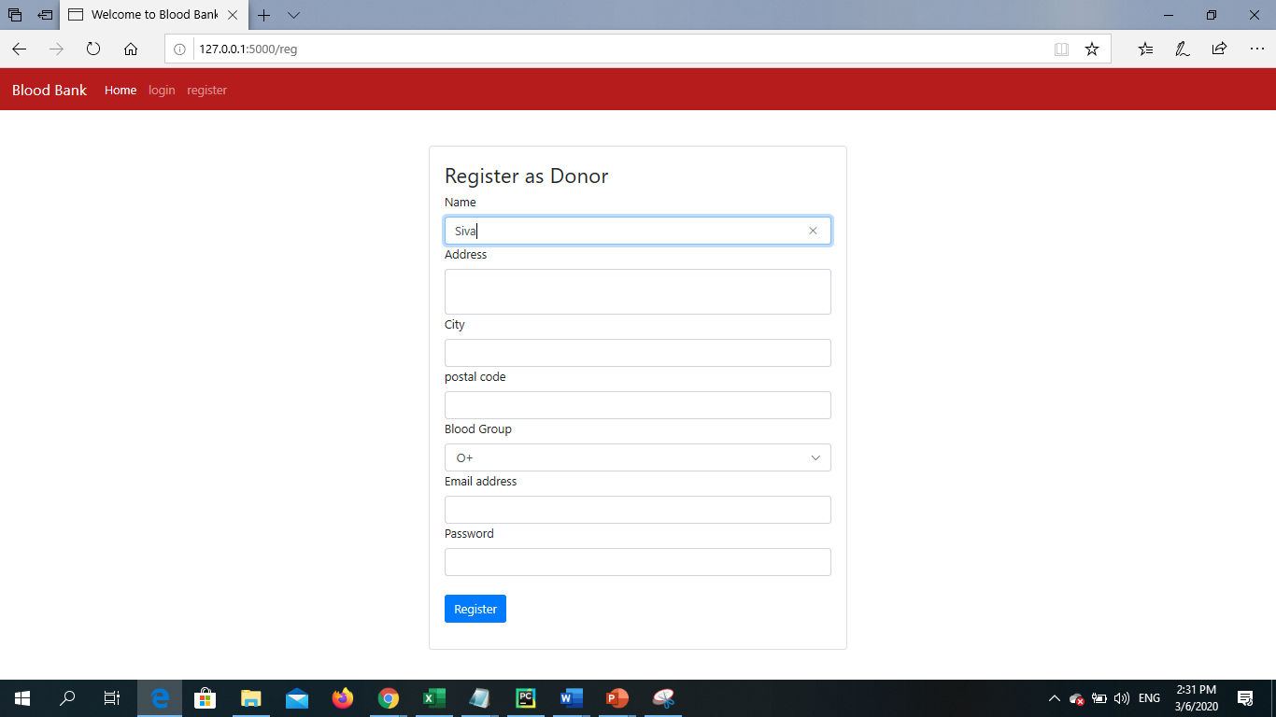
BloodBank Web - Users (Part 1)
Step 1
Register as Donor
Name, Address, Blood Group, Email address, Password
Step 2
User Login
Login with email ID and password
Step 3
Search and check notification
User can search by blood group & donorname.

Slide 6
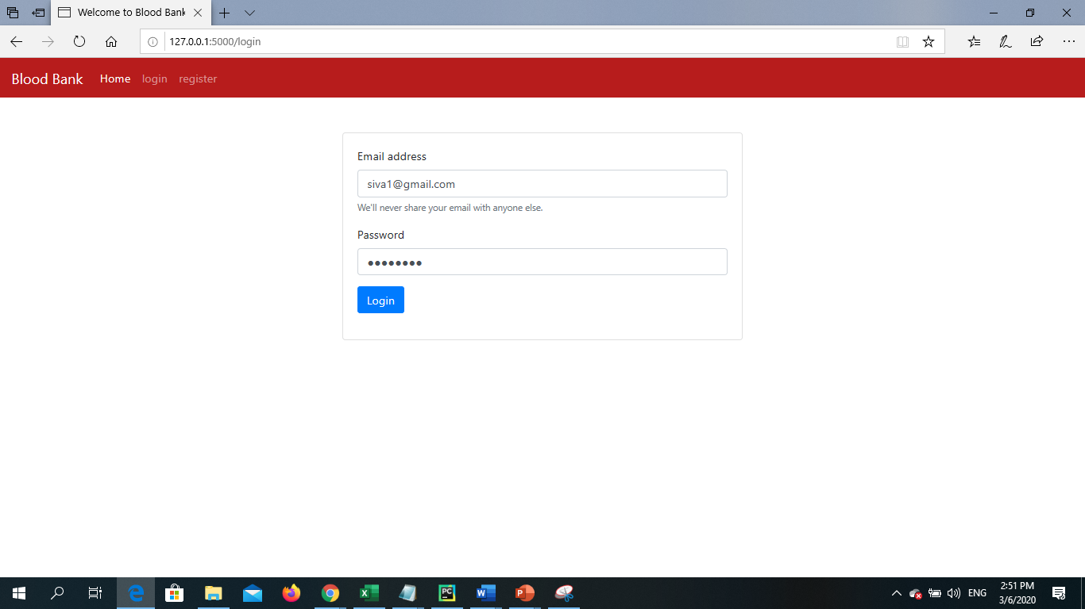
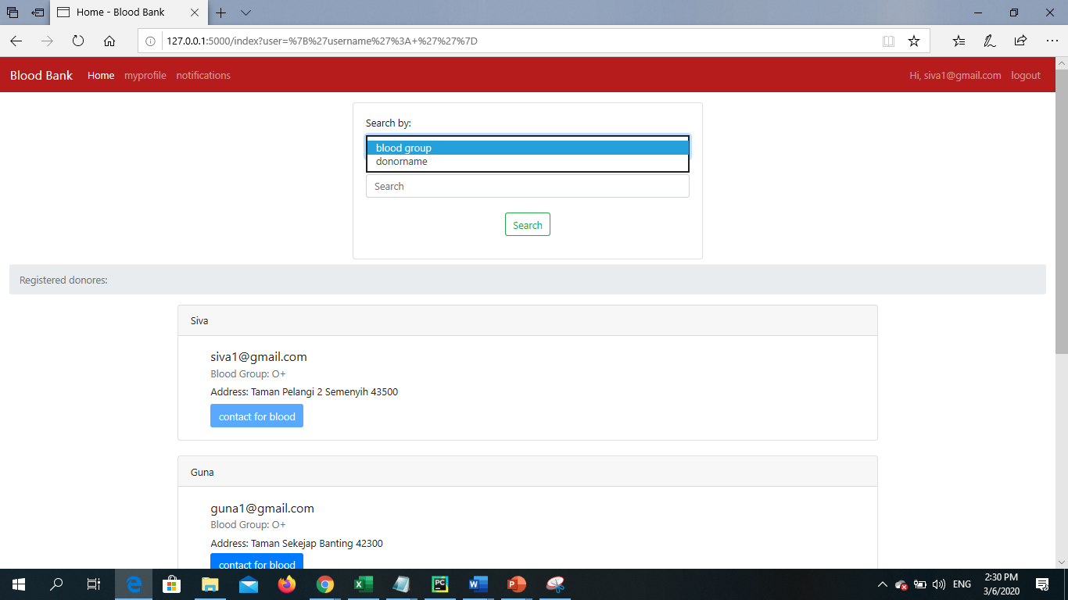
BloodBank Web – Users (Part 2)
User’s Login Page
Search option

Slide 7
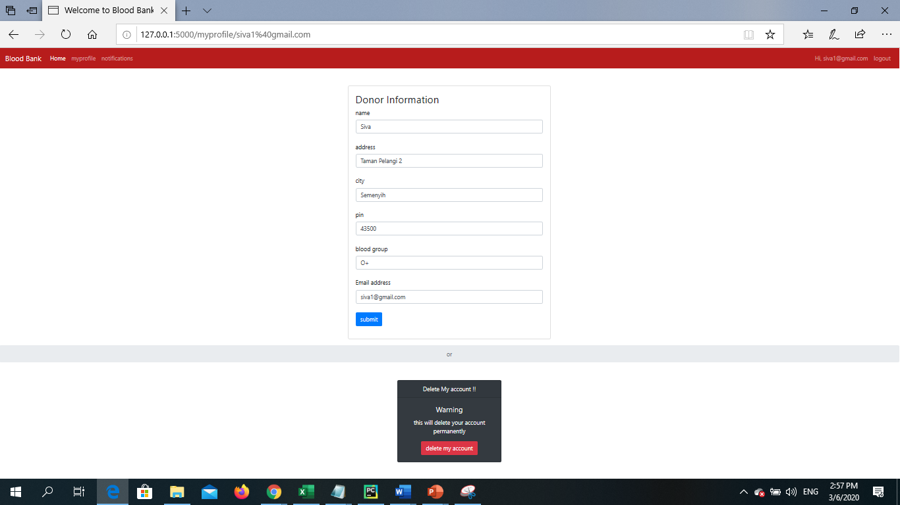
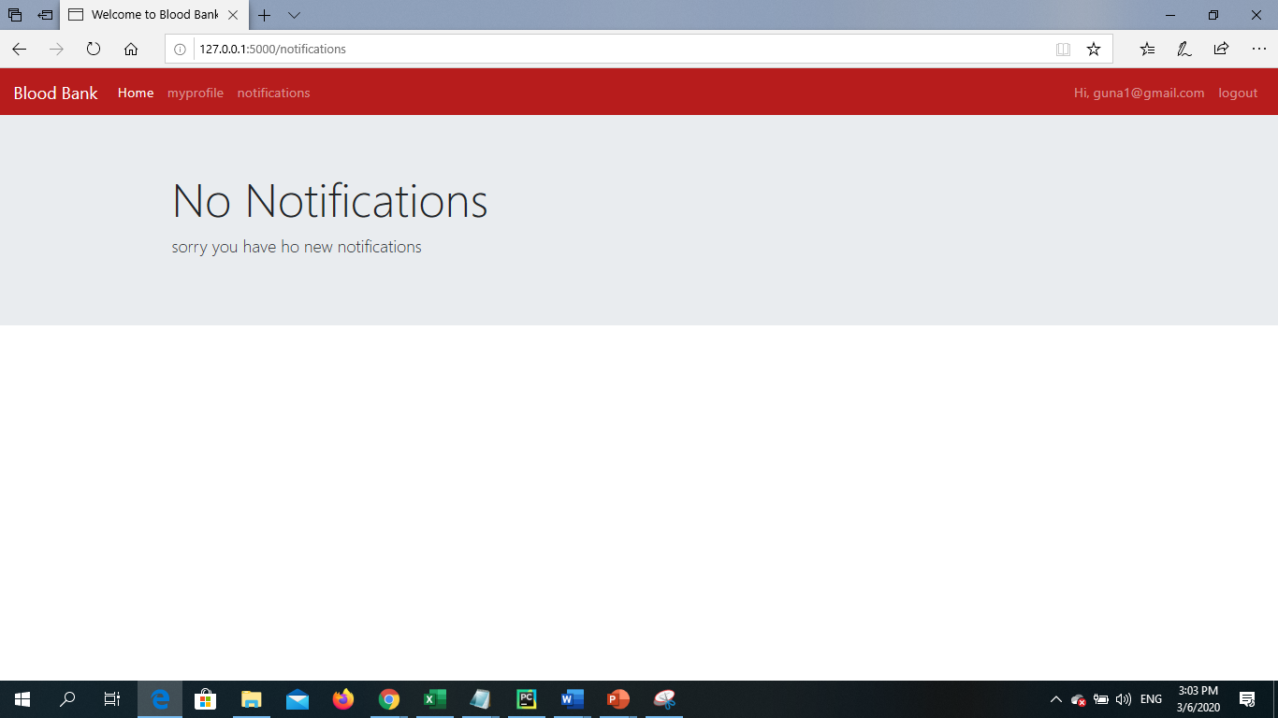
BloodBank Web – Users (Part 3)
Donor Profile & Delete Account
Check Notification

Slide 8
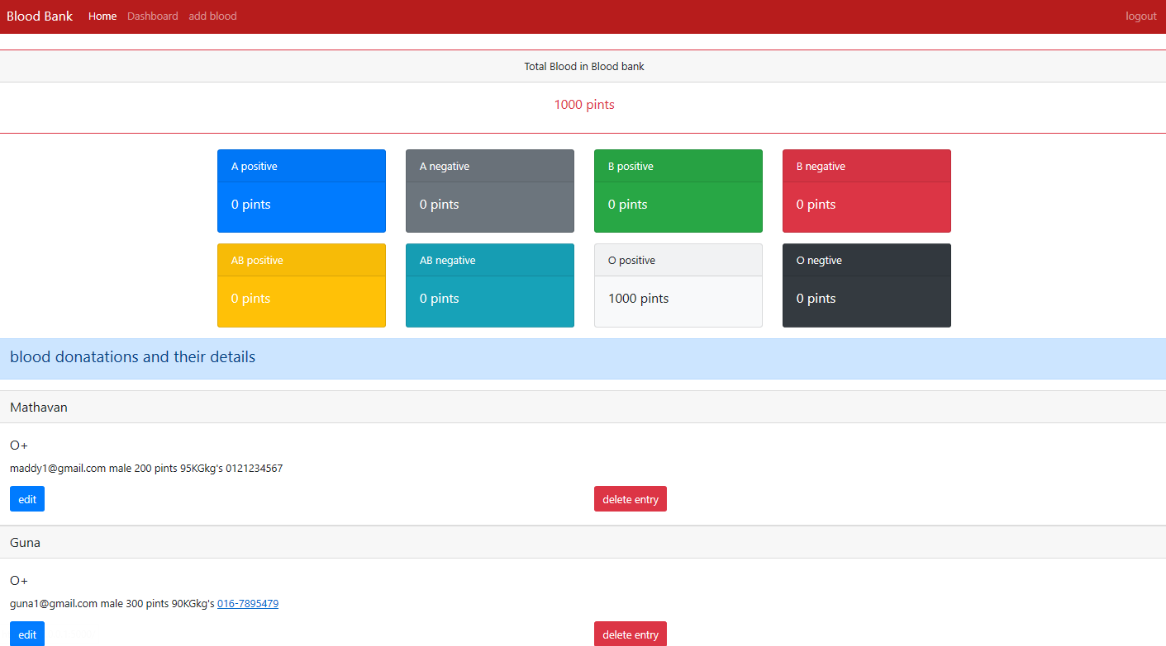
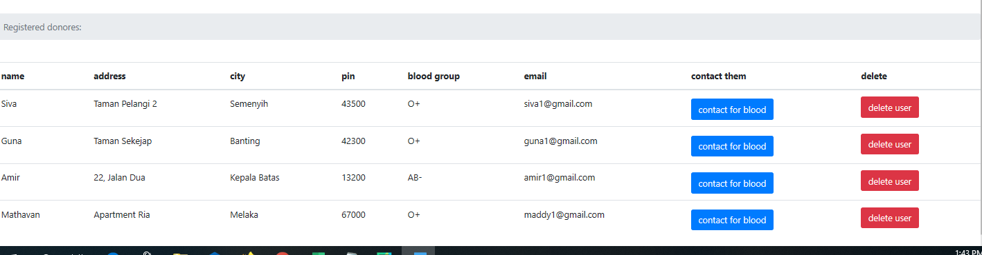
BloodBank Web – Admin (Part 1)
Dashboard View - Admin

Slide 9
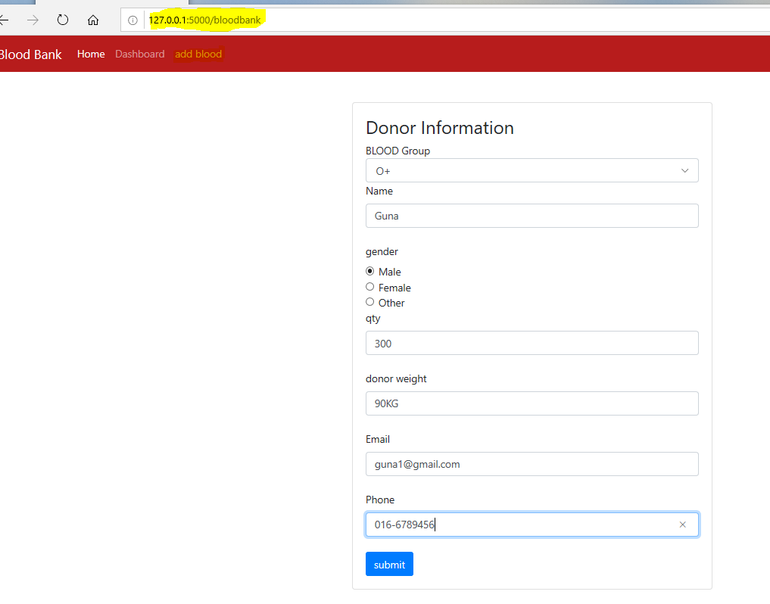
BloodBank Web – Admin (Part 2)
Add Blood – Adding new donor’s information as per below :-
Blood group
Name
Gender
Quantity
Donor’s weight
Contacts (email & phone number)

Slide 10
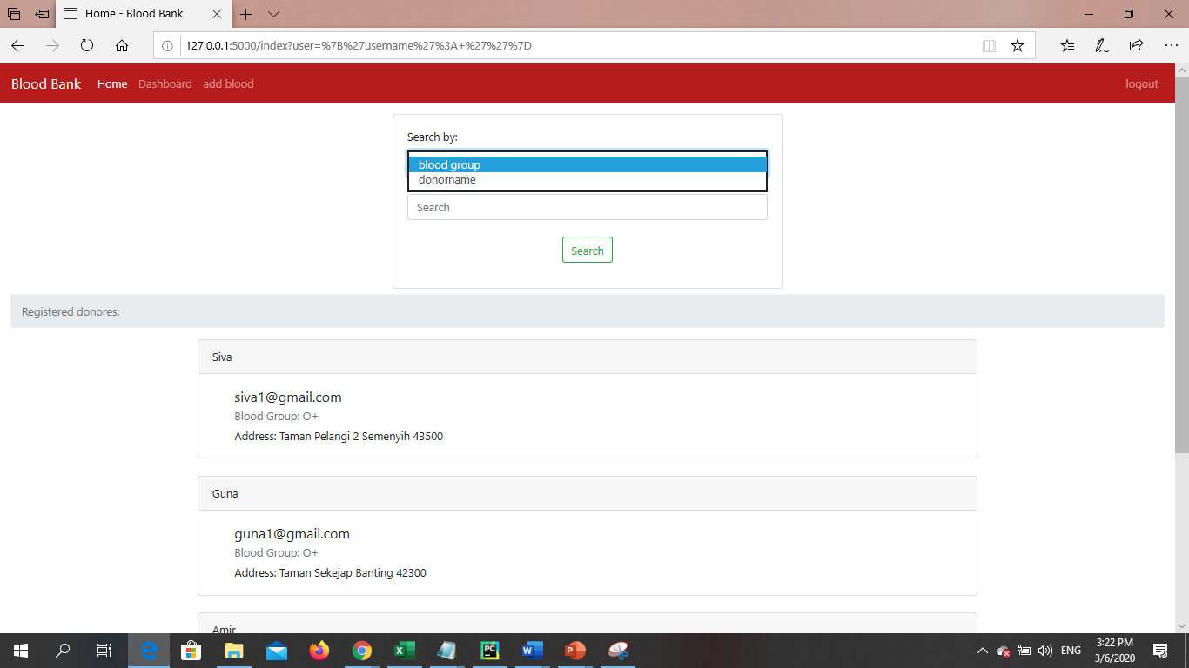
BloodBank Web – Admin (Part 3)
Home View – Search by

Slide 11
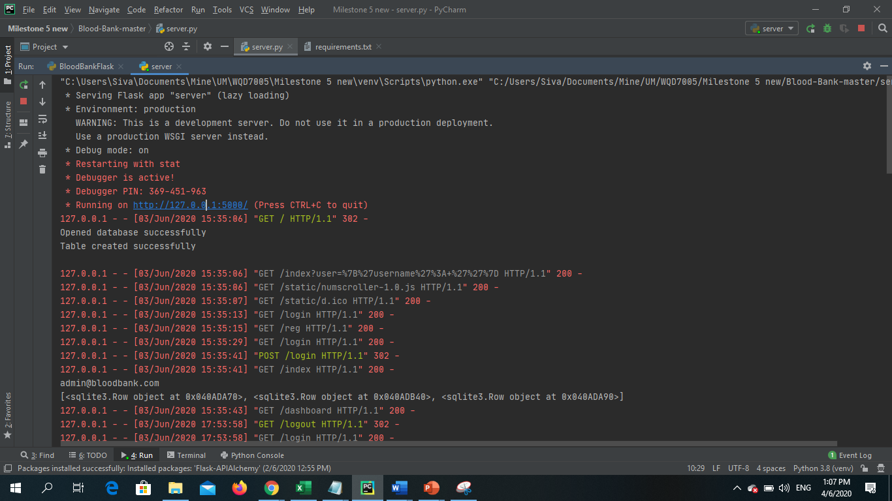
BloodBank Web – Backend
Once the codes (server.py) been executed it will indicate that “Running on http://127.0.0.1:5000/.
That’s the local host IP where the web will be hosted.
Time to time all the activity or transaction on the web (eg : create account, login, adddonor, and etc) will be captured as its read/write in database.

Slide 12
Let’s move to live demo..
Thank you Prof. Dr. Teh Ying Wah.

